Slide 1
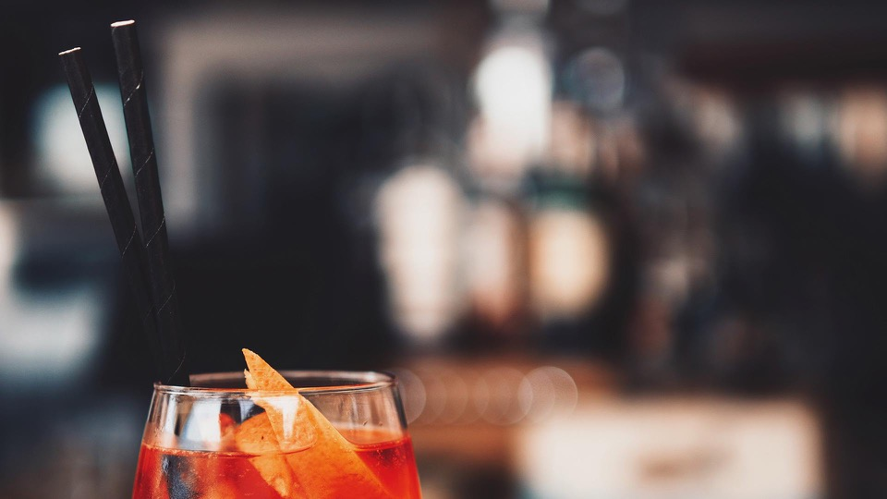
Bôkan Restaurant Rebranding Data Science Consulting Project – March 2020
X-HEC - Capgemini Invent
Group 6

Slide 2
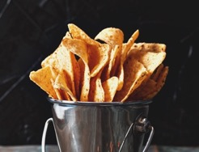
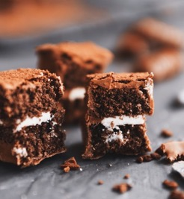
OUTLINING YOUR GOAL
→ Rebrand the restaurant
Innovation in the choice of cuisines and the menu
Space rebranding based on analysis of data collected
→ Increase profit margin
Breakeven Estimation
Expansion of Client base
Securing higher performance

Slide 3
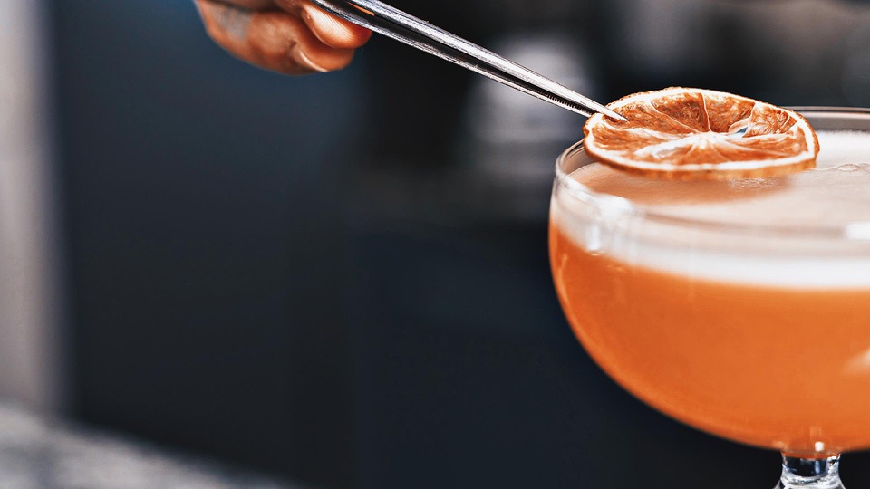




TEAM
TOMMY TRAN
ISMAIL MAJJAD
THOMAS DE MAREUIL
BADR EL-IDRISSI MOKDAD
AKHILA VANGARA

Slide 4
PROJECT TIMELINE
FEBRUARY
MARCH
Intermediate results
Final presentation
Overall project
Efficient
rebranding
Problem definition
recommendations
AI analysis
Based on
Cost & revenue estimation
NLP
analysis
Recommendations

Slide 5
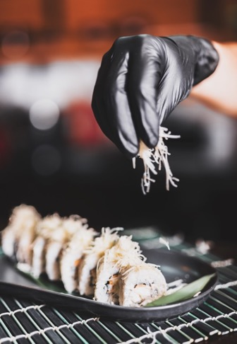
01
REGULAR BUSINESS APPROACH TO YOUR PROBLEM
02
OUR ADDED-VALUE : TECHNICAL ANALYSIS
03
OUR RECOMMENDATIONS
AGENDA
04
AFTER THE REBRANDING

Slide 6
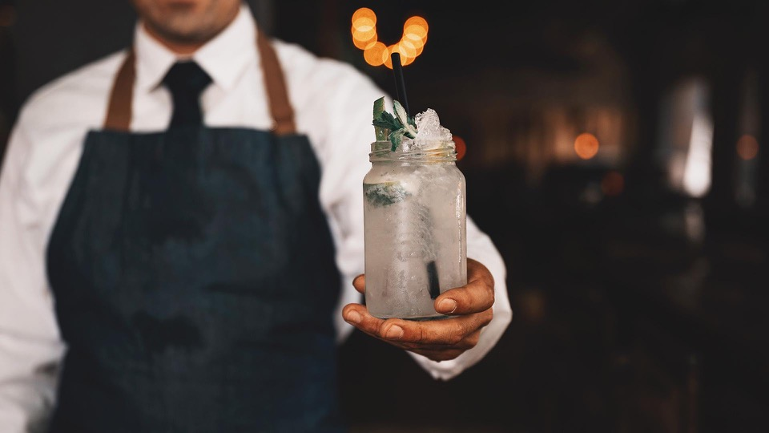
01
REGULAR BUSINESS APPROACH
Market research
Marketing analysis

Slide 7
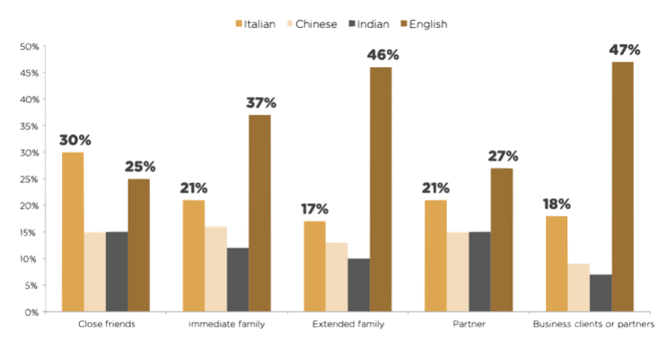
MARKET TRENDS – Pub restaurants and English cuisine are the preferred choice for business meals
As presented below, our research suggests that Pub restaurants and English cuisine are the most popular restaurant types in London – they are both the most numerous venues, and the preferred type for business meals.
Preferred restaurant type depending on situation (London Evening Standard, 2018)

Slide 8
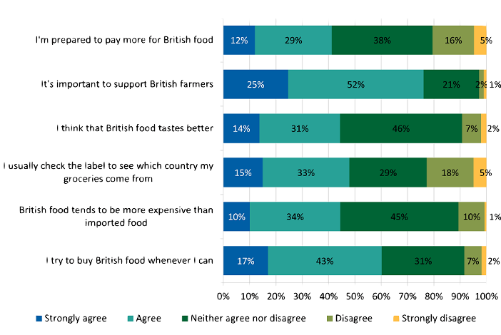
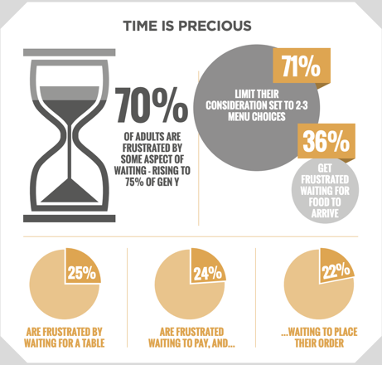
MARKET TRENDS – Clients value primarily local food and efficient service
We also found out that clients particularly value locally-sourced food (the first figure even suggests that 42% of them are ready to pay more for British food), and that waiting time was the main pain point in London restaurants.
Customer attraction for local food (inew.co.uk, 2019)
London client preferences, infography (TimeOut, 2017)

Slide 9







COMPETITION – Main competitors in Canary Wharf have a strong brand identity
The restaurant market in Canary Wharf has specific features related to its location:
We identified 2 restaurants as Bokan’s main competitors in the area. They both have a very strong brand identity:
Restaurants focused on corporate dining, bars focused on afterwork drinks
≈ 120,000 people working in Canary Wharf daily (2019), and thousands more coming as visitors
Japanese-style dishes in a modern setting
Argentinian cuisine with premium beef and wine
Strong competition, with main compeitors on the high-end segment being Roka and Gaucho
Local restaurants can source some of the finest catches at Billingsgate fish market, the UK’s largest inland fish market, right next to Canary Wharf
Branded as “European cuisine”: less strong identity

Slide 10
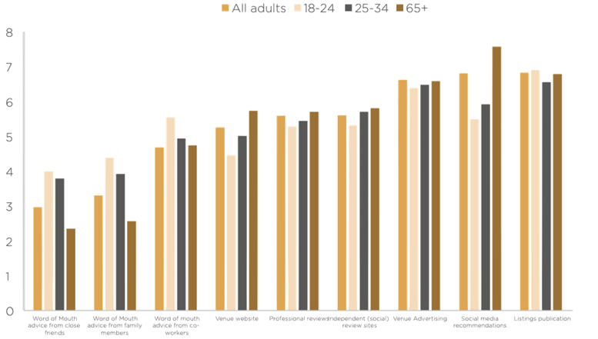



MARKETING STRATEGY – Bokan is behind competitors for its presence on Instagram
Social media is among the most important channels for restaurant choice, in all age groups:
We identified 2 restaurants as Bokan’s main competitors in the area. They both have a very strong brand identity:
18K likes
12K followers
9K likes
43K followers
12K likes
26K followers
Preferred communication channels for decision-making (London Evening Standard, 2018)

Slide 11
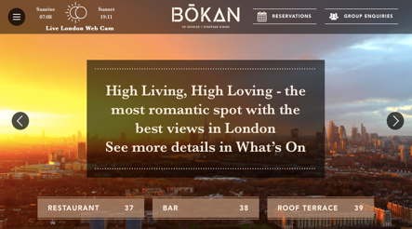
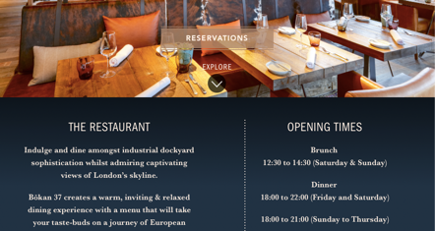
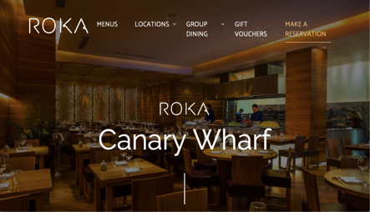
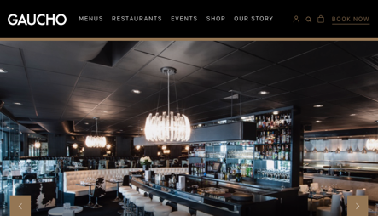
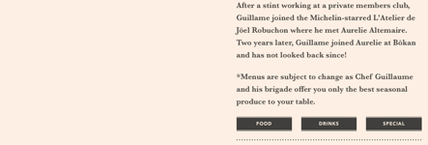
ONLINE USER EXPERIENCE – Bokan’s UX is less fluid than competitors
We analysed Bokan’s website, with in mind the famous “15 second rule”: when looking for information, customers usually don’t spend more than 15 seconds on your website
To find the restaurant menu on Bokan’s website, you have to scroll through 3 different pages, vs. a single click on the homepage for Roka and Gaucho (see red boxes on images)

Slide 12
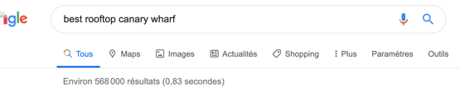
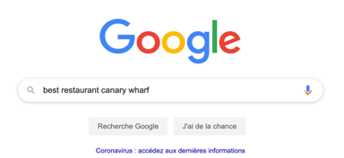
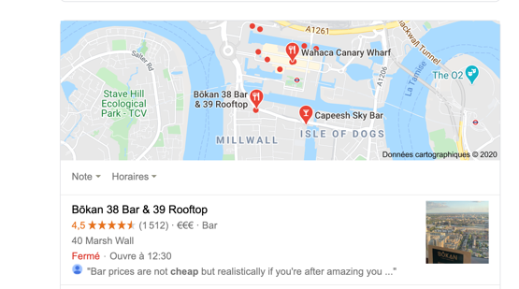
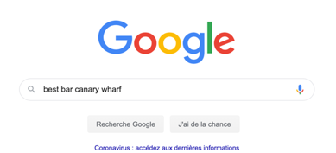
SEARCH ENGINE OPTIMIZATION – Bokan is listed by Google as best rooftop in Canary Wharf
When searching for “best rooftop canary wharf”, Bokan is the first result:
When searching for the best restaurant in Canary Wharf, Bokan is behind Roka:
Bokan 37: 3 occurences on first page of results
Roka: 8 times on first page
Bokan 38: 5 times on first page
Roka: 5 times on first page

Slide 13




UPDATED SWOT ANALYSIS (1/2)
Based on this new business research, we were able to update the SWOT analysis from our intermediate presentation:
Strengths
Weaknesses
Flexibility: the menu changes regularly and offers local food, which was an important point in our findings
Brand identity: compared to top competitors, the restaurant isn’t focused on a specific cuisine and has a more common ‘modern’ atmosphere
Client experience: the live music events and the breathtaking rooftop view are strong competitive advantages
Online presence and experience: presence on Instagram and user website experience are behind competition
Staff quality: experienced French chef Guillaume Gillan is in charge of the kitchen
Access means: the restaurant & bar are on the 37th and 38th floor of a hotel, which requires additional marketing efforts so that clients find them easily

Slide 14



UPDATED SWOT ANALYSIS (2/2)
Opportunities
Threats
Location: location in an international hotel in Canary Wharf allows for a solid & predictable client base year-round
Competition from new business: growing trend over new types of restaurant such as fancy fast-foods or vegan restaurants
Pricing power: business clients are less sensitive to prices – focus on location, experience, quality
Competition from existing business: clients might want to stick to landmarks with strong identity such as Roka & Gaucho
Unoccupied niche: no restaurant in the area focuses on what our analysis identified as the preferred food type in London: British / (high-end) pub cuisine
Slowdown in activity with Brexit: banks moving offices to France or other EU countries might impact Canary Wharf.
In this first section we identified several issues, using a traditional business approach (market research, SWOT). We will complement them with a technical analysis, and propose solutions in the Recommendations section.

Slide 15
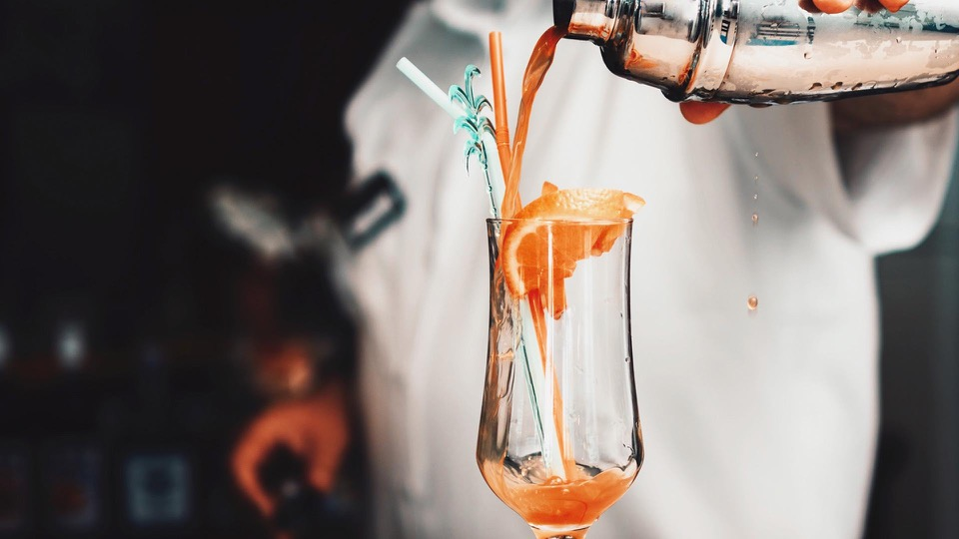

02
OUR ADDED-VALUE : TECHNICAL ANALYSIS
Web scrapping
Review embeddings
Topic extraction

Slide 16
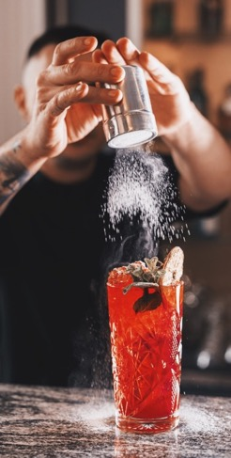
OUR ADDED VALUE – Natural Language Processing (NLP) to complement business findings
To bring value on top of the regular business approach, we conducted an AI-based technical analysis, using reviews from Tripadvisor.com for restaurants in London.
We built a NLP model to understand what makes restaurants successful (or not!) in London, and provide more accurate recommandations for Bokan’s rebranding.
Our technical analysis went through the following steps:
01
02
03
Collect and clean Data
Build a Word Embedding model to prepare analysis
Conduct Topic Extraction to help build recommendations

Slide 17
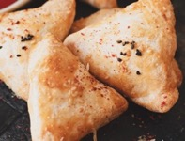
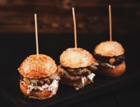
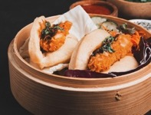
DATA COLLECTION & DATA CLEANING
01
STEP
Web Scrapping
Tokenization
Lemmatization
Collect as many reviews on the Internet as possible (several thousands)
Break a stream of text into words, phrases, or other meaningful elements called tokens
Reduce inflection in words to their root forms ensuring that the root word belongs to the language

Slide 18
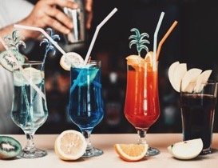
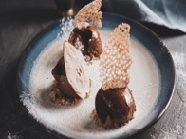
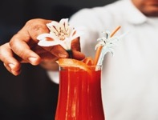
REVIEW EMBEDDING
02
STEP
Embedding
LSI
Word2Vec
Representation in which a word is associated to a numeric vector. We can then perform calculations and operations on embedding matrices
Mathematical method for modeling the meaning of words and passages by analysing a corpus of texts
Embedding method which embarks a neural net with context and target word notions
&

Slide 19


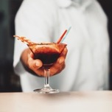
TOPIC EXTRACTION
03
STEP
Topic extraction
LDA
GSDMM
Method to identify the latent topics in the corpus of reviews and the words most related to each topic
A statistical model that views each review as a mixture of topics and each word as related to one of the topics
A variant of the LDA model to extract topics through clustering of shorter texts
&

Slide 20
TOPIC EXTRACTION – Most relevant topics in high reviews confirm market trends observed in our market research
We extracted the topics most relevant to high reviews (4-5 stars) in London:
Some topics reveal the preferred types of food in London (Italian, pub food, burgers, etc.):
Some topics reveal the elements most valued by clients in good reviews (short wait time, live music, etc.) :
Italian food – pizza, pasta, wine
Service details – recommendations, wait time, order time, events
Main course meals – Fish & chips, burgers, steak, sushi, meat
Atmosphere – pub, drinking, live music, garden, atmosphere
Smaller meals – tea, breakfast, eggs, sandwich
Simple location-related topic – street, venue, London, restaurant
Additional details in Appendix
These results complement and confirm our previous findings concerning the preferred types of food in London (Italian, English/pub cuisine) and the most relevant items for client satisfaction (wait time, atmosphere/identity).

Slide 21
TOPIC EXTRACTION – Most relevant topics in low reviews also highlight the main pain points
We used a Word Cloud to reveal the most occurring words in 1-star reviews:
Putting aside the common words such as ‘restaurant’ or ‘food’, we can see that relevant words include vocabulary related to service (‘staff’, ‘order’, ‘time’ ‘rude’, ‘service’, ‘manager’) and to food quality (‘cold’, ‘price’, ‘disappointed’)
Again, this confirms our finding that service and waiting time issues are of particular importance for customer satisfaction
Thanks to a technical analysis using AI methods, we were able to confirm and complement the ‘business’ findings of the first section. Using these results, we crafted rebranding recommendations, presented in the next section.

Slide 22
03
OUR RECOMMENDATIONS
Rebranding & prototype
Other strategic advice

Slide 23
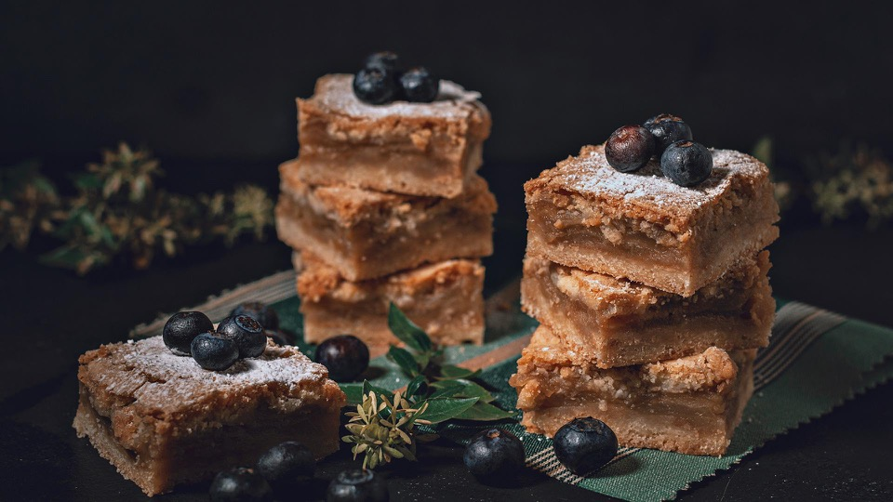
Bokan, the new “Gastronomic pub” reference in London
OUR VISION

Slide 24
Marketing strategy
A CONTEMPORARY INTERPRETATION OF BRITISH AUTHENTICITY
Both our market/business research and our technical analysis show that English and pub cuisine are the top choices in London. We present in the next slides the 3 axes we recommend for Bokan’s rebranding.
The “gastro pub” term might not be the fanciest one, but it’s very trendy and represents a clear opportunity for Bokan. What’s more, Bokan already has most elements in place – rebranding could be quick and reasonably costly.
Interior design
New menu
Build on existing decoration to enhance the experience of contemporary British authenticity
Keep Bokan’s name for coherence / existing customers
Rebrand the restaurant as high-end pub cuisine
Keep local sourcing and regularly changing menu
Apply slight price increase (see next slides)
Creative agency to redesign website and print material
Social media campaign targeted to London area
Marketing in specialized magazines to support change

Slide 25
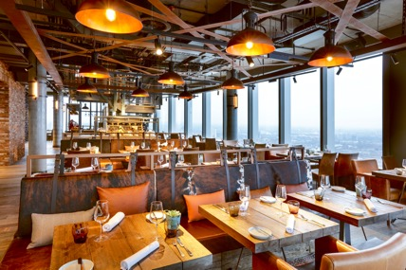
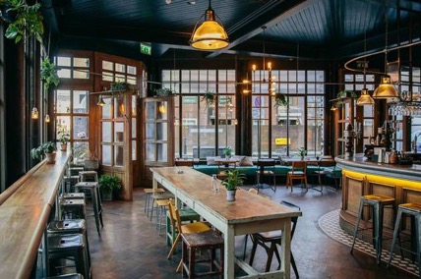
FINE-TUNE INTERIOR DESIGN AND ATMOSPHERE
Typical gastro-pub features include: comfortable leather sofas, thick wood, industrial materials (brick and metal), references to game hunting, Victorian-style flowers (less modern, not recommended here)
Fortunately, Bokan already has much of these elements (see on right): deep seats with cow skin, thick wood tables, brick wall (left wall). It mixes it with a modern industrial design of metal & glass
Pushing further in current direction would give Bokan a strong identity and offer clients a contemporary pub experience
Bokan 37 (top) and Culpeper, London (bottom)
Our main inspiration for decoration is the Culpeper, one of the most renowned gastronomic pubs in London (see on right), with similar industrial fittings (glass and metal), a little more green features
(climber plants), and a daily-changing menu of modern British dishes

Slide 26
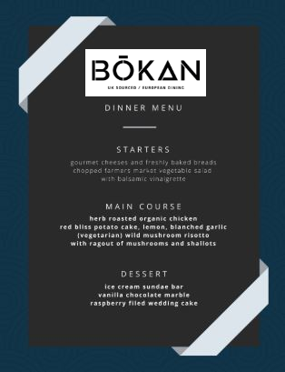
BUILD A NEW MENU – Prototype
Our new menu prototype includes typical British / pub cuisine (red bliss potatoes, chocolate marble…)
It also includes food that can be locally sourced (organic chicken, market vegetables…) and seasonally changed. Bokan can keep its current ‘UK sourcing’ engagement and existing supply channels, which reduces transformation costs
Along with menu changes, we recommend Bokan to apply a ≈ +10% price increase on dinner prices (see revenue estimation in next section)
The sleek menu design (indicative – to be reviewed by a creative agency) remains coherent with Bokan’s authentic but contemporary atmosphere

Slide 27
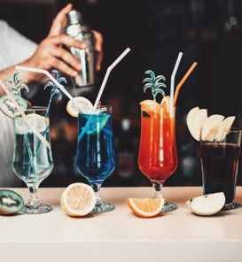
LAUNCH A NEW MARKETING & ONLINE STRATEGY
Bokan is behind competitors regarding presence on Instagram (cf. marketing analysis in the 1st section), which is increasingly important to drive new customers
The user experience on Bokan’s website is less fluid than main competitors, with several clicks required just to find the menu
A marketing campaign, both print (specialized magazines) and online (social media), will be required to broadcast Bokan’s new brand image and attract new customers
A creative agency will also be required to redesign the website, visual identity, menu and print material according to the new brand orientation
Bokan has all what’s needed to reinvent the high-end British pub and become a reference restaurant in London. In the next (and last) section, we estimate revenue post-rebranding, rebranding costs and breakeven, and key KPIs.

Slide 28

04
AFTER THE REBRANDING
Revenue estimation
Costs & breakeven estimation
Key KPIs to monitor

Slide 29




REVENUE ESTIMATION POST-REBRANDING – Restaurant
Based on our recommendations, we updated the revenue estimation from our intermediate presentation
We estimated that the rebranding could help reach a +10% in revenue and +15% in profits at a 2-year horizon, which would bring total revenue at c. £7.5M per year. This not an engagement, but an estimation, which can depend on multiple factors. We listed the most relevant KPIs in the last section of this report. We detail our estimations post-rebranding below:
RESTAURANT
1- BRUNCH
2- DINNER
70 seats 2 services
70 seats 2 services
50% Occupancy rate
+5%
80% Occupancy rate
100% Fri/Sat 80% Sun 70% Other
70 people eating
110 people eating
Menu (food+bev) at £52
£50 per person
+10%
Menu (food+bev) at £52
£25 per person
+10%
£52 per person
£75 per person
£3,700 per brunch
£8,200 per dinner

Slide 30
REVENUE ESTIMATION POST-REBRANDING – Bar / Rooftop
BAR / ROOFTOP
1- 12h–15h
2- 15h–19h
3- 19h–00h
50 seats
50 seats
50 seats
Winter: 20% Occupancy rate
Winter: 50% Occupancy rate
+10%
Winter: 60% Occupancy rate
Summer: 50% Occupancy rate
Summer: 90% Occupancy rate
Summer: 90% Occupancy rate
+5%
+5%
£20 per person
£12 per person
£12 per person
£20 per person
£30 per person
£40 per person
+10%
+5%
Winter: £600
Winter: £2,100
Winter: £3,900
Sub-total:
Summer: £1,500
Summer: £3,800
Summer: £5,800
Total:
£6,600 per day in winter
and
£11,100 per day in summer

Slide 31
Restaurant / Brunch
Restaurant / Dinner
Bar & Rooftop / Winter
Bar & Rooftop / Summer
REVENUE ESTIMATION POST-REBRANDING – Key takeaways
£3,700 per lunch
355 days
1.3 M£ per Year
£8,200 per dinner
355 days
3.1 M£ per Year
£6,600 per day
8 months
1.6 M£ per Year
£11,100 per day
4 months
1.5 M£ per Year
Total Revenues: £7.5M per year

Slide 32
COSTS & BREAKEVEN ESTIMATION – Fixed and variable costs
We evaluated Bokan’s different costs, in order to provide a breakeven estimate:
Cost Of Goods Sold
Other variable costs
Fixed costs
COGS represent ≈30-35% of Sales for fine-dining restaurants (market research)
Local sourcing brings costs up, while efficient inventory management brings them down
Bokan already has a local sourcing strategy with an existing network of local suppliers
Therefore we would recommend Bokan to target COGS at 30% of Sales
→ Total: £2.3M per year
Labour costs: 25%
Utilities: 2%
Marketing costs: 3%
→ Total: £2.3M per year
Rent: 5% of Sales (0% if the building is fully-owned by Novotel)
Other fixed costs (overheads, licensing, IT, kitchen material maintenance): 10%
→ Total: £1.1M per year
Total variable costs: £4.6M (→ Gross Margin ≈ 38%)
Total fixed costs: £1.1M

Slide 33
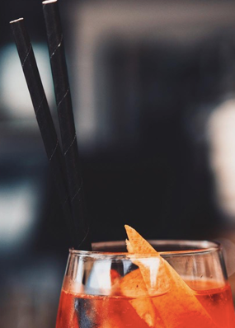
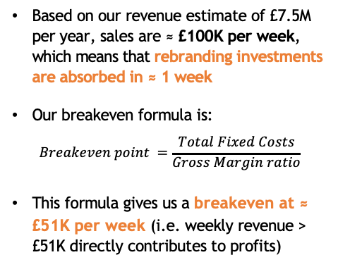
COSTS & BREAKEVEN ESTIMATION – Rebranding and breakeven
Rebranding investments
Breakeven point
As most of the current decoration already fits the contemporary pub atmosphere, new decoration: ≈ £30K
New branding (creative agency for website, print, etc.): ≈ £30K
Additional marketing campaigns (social media, specialized magazines): ≈ £40K
Based on our revenue estimate of £7.5M per year, sales are ≈ £100K per week, which means that rebranding investments are absorbed in ≈ 1 week
Our breakeven formula is:
$$Breakeven point =\frac{Total Fixed Costs}{Gross Margin ratio}$$
This formula gives us a breakeven at ≈ £51K per week (i.e. weekly revenue > £51K directly contributes to profits)
Rebranding costs (capex): £100K
With a breakeven point well under its weekly revenue estimate (post-rebranding), and with relatively reasonable rebranding investments (absorbed in ≈1 week of sales), Bokan is bound to be significantly profitable.

Slide 34

Key Performance Indicators (I)
Lastly, in order to prepare the ground for performance monitoring after the project, we identified several important KPIs to follow:
Sales
Breakeven point – Making sure profitability is is reached back quickly after rebranding investments
Gross Profit (Sales – COGS) – Keeping an eye on the cost of goods sold to maintain profits
Social Media
Engagement – Number of likes, shares, retweets or comments for each post
Reach – Social media audience: number of followers, traffic data, etc.
Customer Feedback
Customer Satisfaction – Monitoring satisfaction through reviews and surveys
Customer Retention Rate (%) – Following the proportion of new clients vs. repetitive clients and build a loyal client base to secure long-term revenue.

Slide 35
Key Performance Indicators (II)
Employee Engagement
Employee Turnover – Keeping experimented employees, that clients know, can help increase customer loyalty and satisfaction.
Employee Satisfaction – can be measured through team meetings and surveys, and help secure efficient employees in the flexible UK market
Front house management
Table turnover rate – to monitor to ensure adequate wait times and maximize sales
Revenue per available seat hour (= total rev / [available seats x opening hours]) – to monitor to optimize labour scheduling, food purchasing and table turnover
Sales per guest – to help restructure menu, e.g. based on time of the day
Menu item profit and popularity – allows for strategic pricing of items on the menu
Based on these monitoring tools and our previous recommendations, we believe that Bokan could go through a successful and valuable rebranding. We remain at your disposal for any further information.

Slide 36
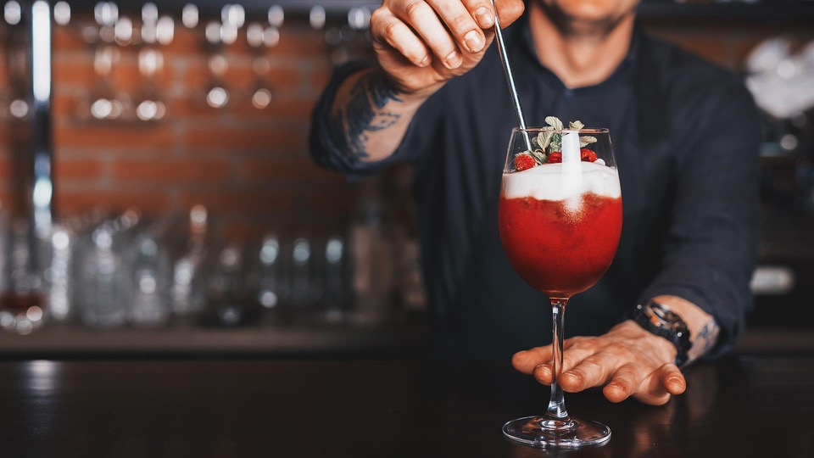
MANY THANKS FOR YOUR ATTENTION

Slide 37
APPENDIX
Additional market research material
Technical analysis supplement

Slide 38
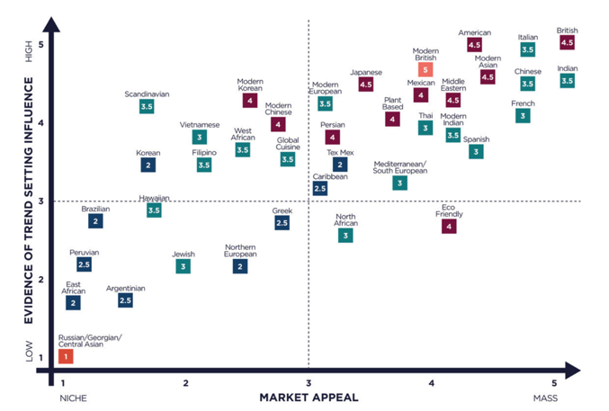
MARKET TRENDS – Most trending types of cuisine in London
This other visualization graph confirms our previous findings
The most trending types of cuisine in London are British and Italian

Slide 39
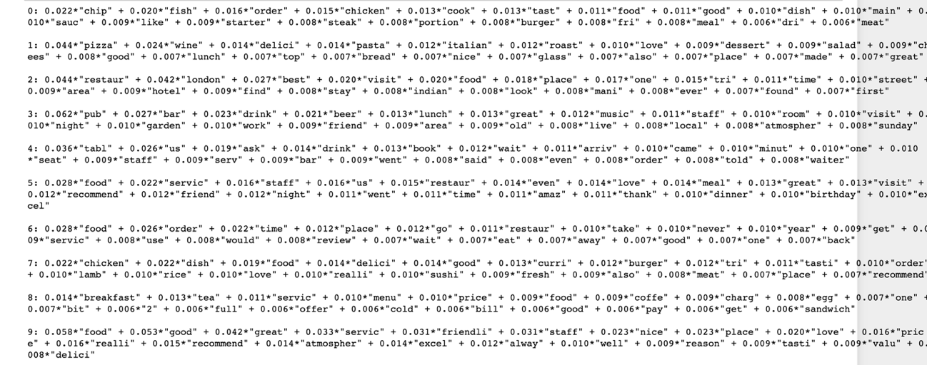
Topic Extraction – LDA output
This is the output of the LDA model. Each topic has distinct words associated, and words are captured along with their associated probabilities to be in a given topic:

Slide 40
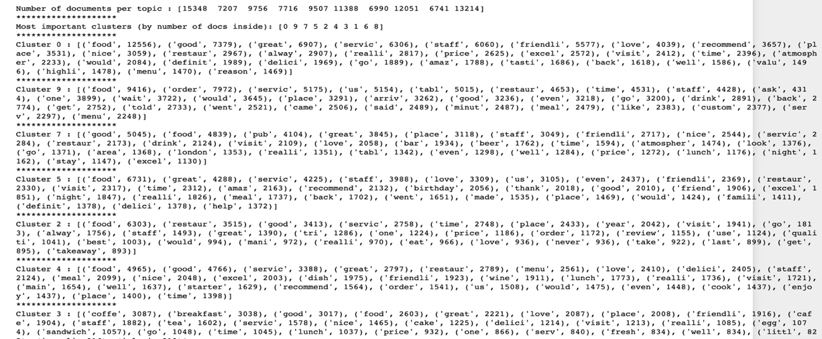
Topic Extraction – GSDMM output
These are the text clusters created by the GSDMM model. It’s a dimension reduction technique: clusters are classified by order of importance (i.e. highest number of documents and of words related to each topic cluster):

Slide 41
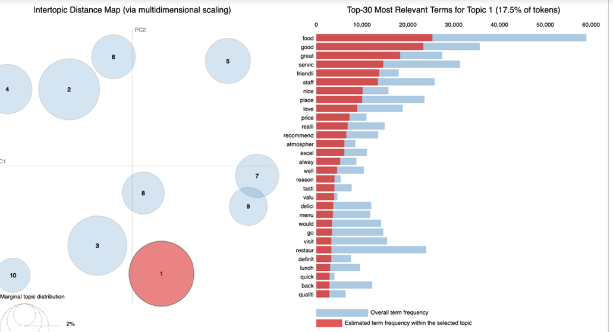
INTER-TOPIC DISTANCE (LDA)
The intertopic distance was plotted to ensure that the topics extracted are in fact independent from each other
pyLDAvis was used to generate these graphs
The topics are plotted against Principal Components – breaking down the data in topics aids in dimension reduction analysis
Most relevant terms per topic and overall were studied to engineer recommendations

Slide 42
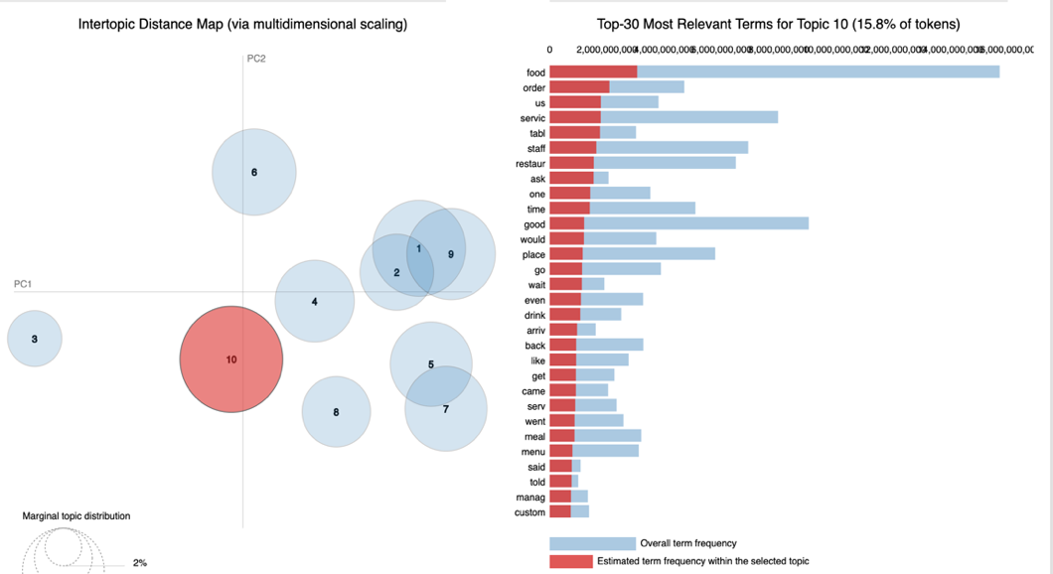
INTER-TOPIC DISTANCE (GSDMM)
Interdistance map is not as well spread out as that for LDA model.
These represent more in details the most important words in each cluster and their frequency of occurrence
It helped us fine-tune our recommendations

Slide 43
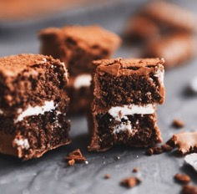
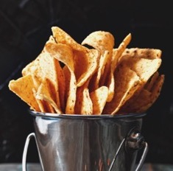
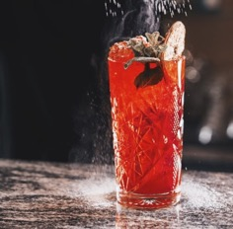
SENTIMENT ANALYSIS
STEP
03 bis
Sentiment analysis
Flair
VADER
We used sentiment analysis as a “bonus” step in our technical analysis. It helped us observe how high ratings are related to positive sentiments
Flair is a library developed by Zalando on top of PyTorch. It combines different word embeddings to beat state-of-the art results in sentiment analysis.
VADER is a model used for sentiment analysis that is sensitive to both polarity (positive/negative) and intensity (strength) of emotion.
&

